Slide 1


USWDS Monthly Call
May 2022

Slide 2

Hi!
Thanks for being here!

Slide 3
Agenda
Site launches
Product updates
Packages and performance
Q&A

Slide 4
Site launches

Slide 5

Pandemic Oversight
pandemicoversight.gov

Slide 6
Great work!

Slide 7
Product updates

Slide 8
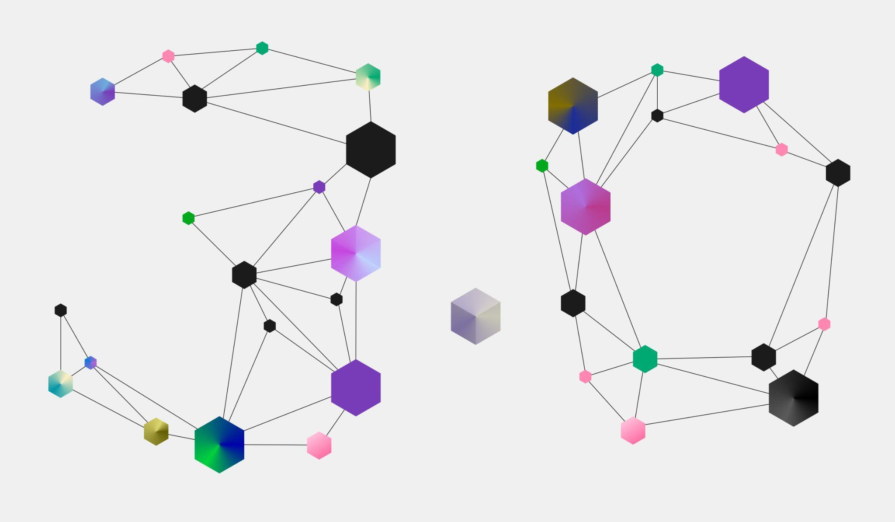
USWDS 3.0 is here

Slide 9
USWDS 3.0
Actually, now it’s 3.0.1

Slide 10
Packages and performance

Slide 11

USWDS 1.0
20 Components

Slide 12
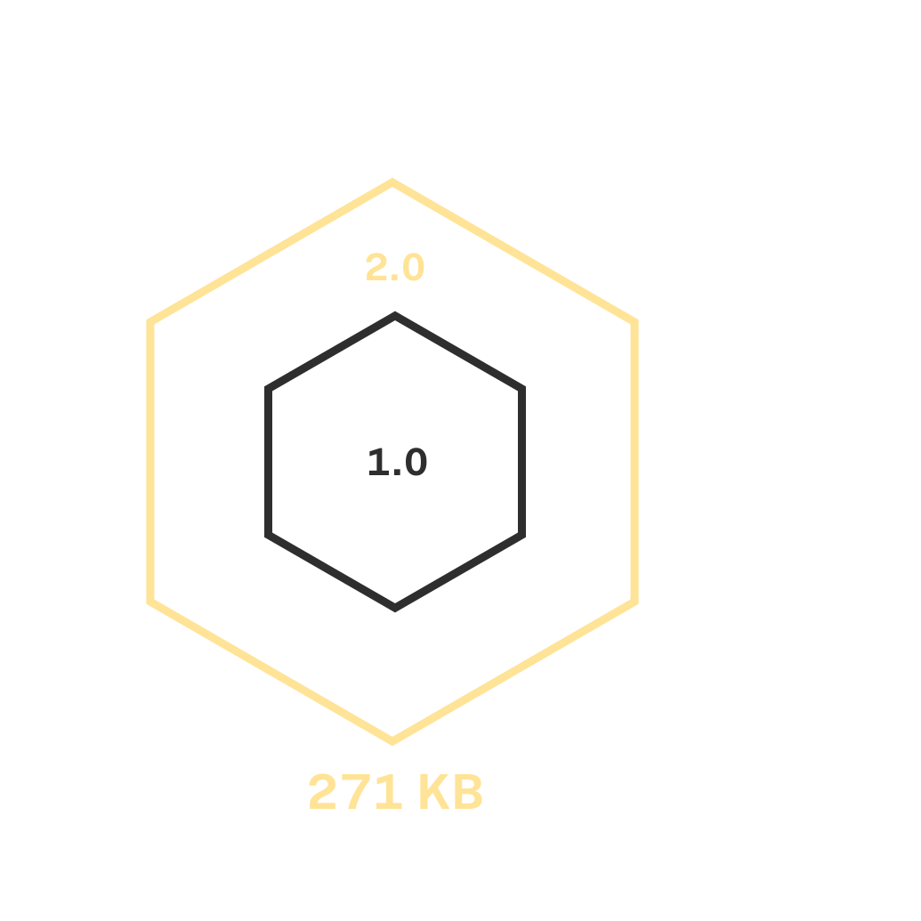
USWDS 2.0
20 Components
Utilities

Slide 13
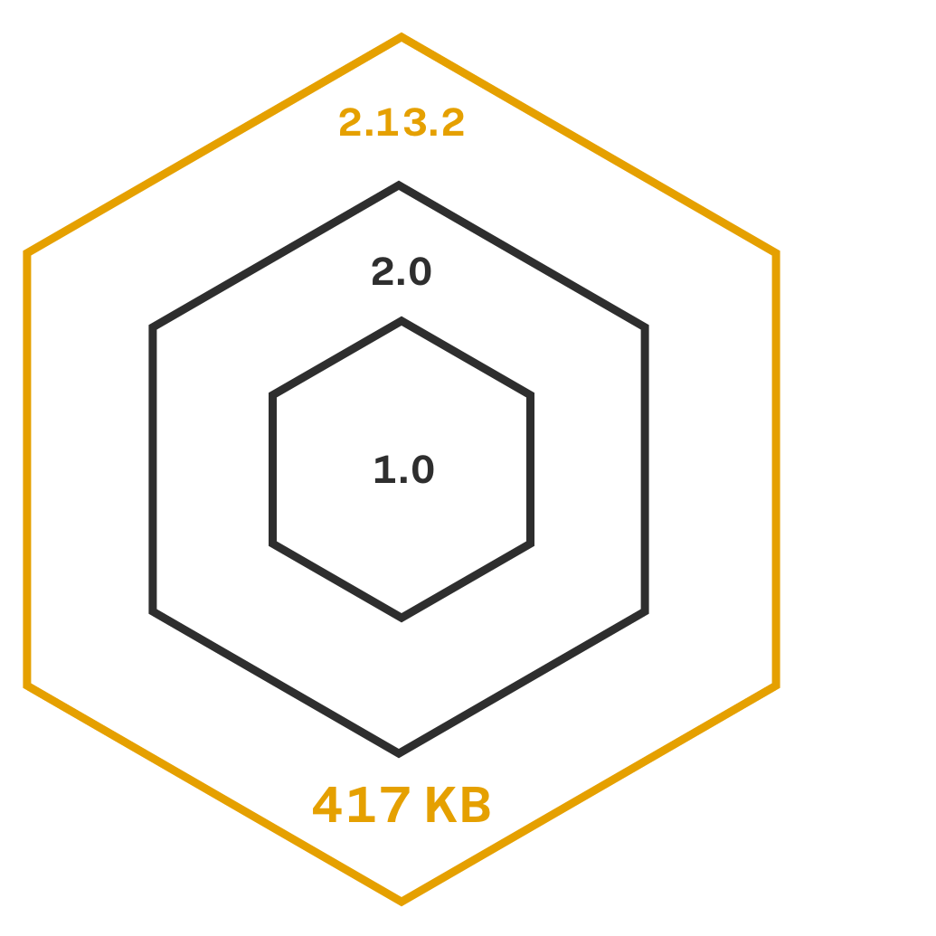
USWDS 2.13.2
40 Components
Utilities

Slide 14
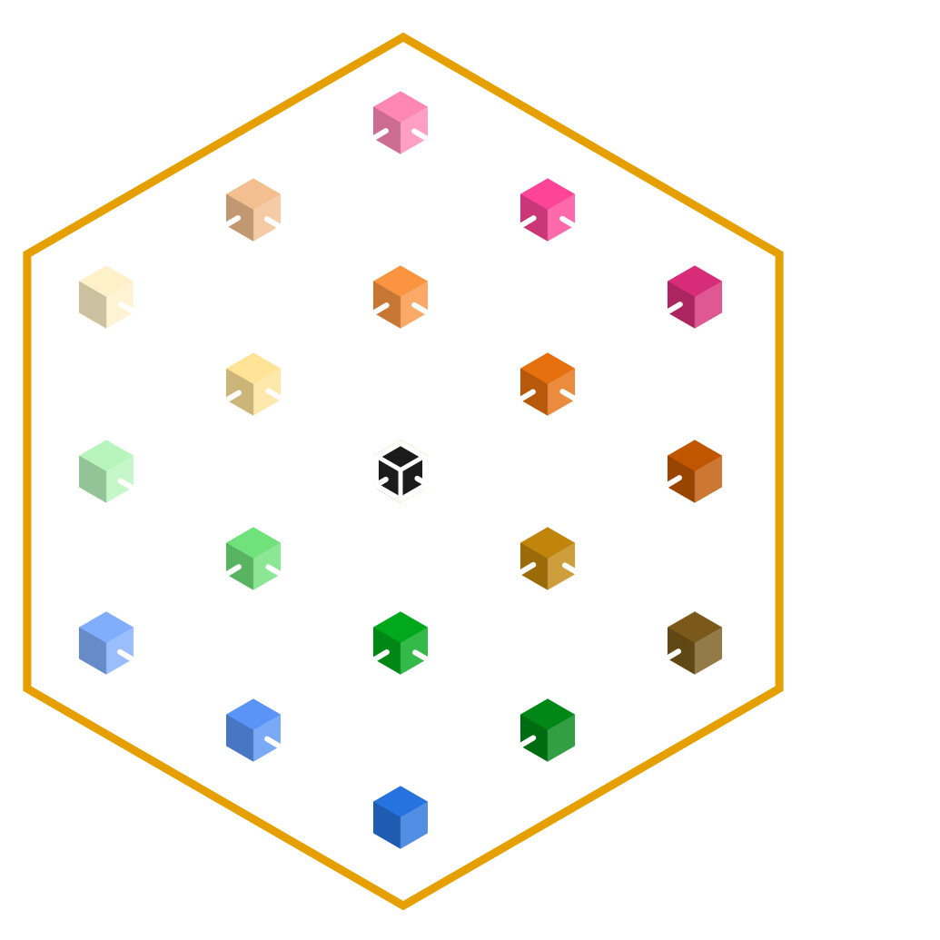
USWDS 3.0
We plan to keep growing.

Slide 15
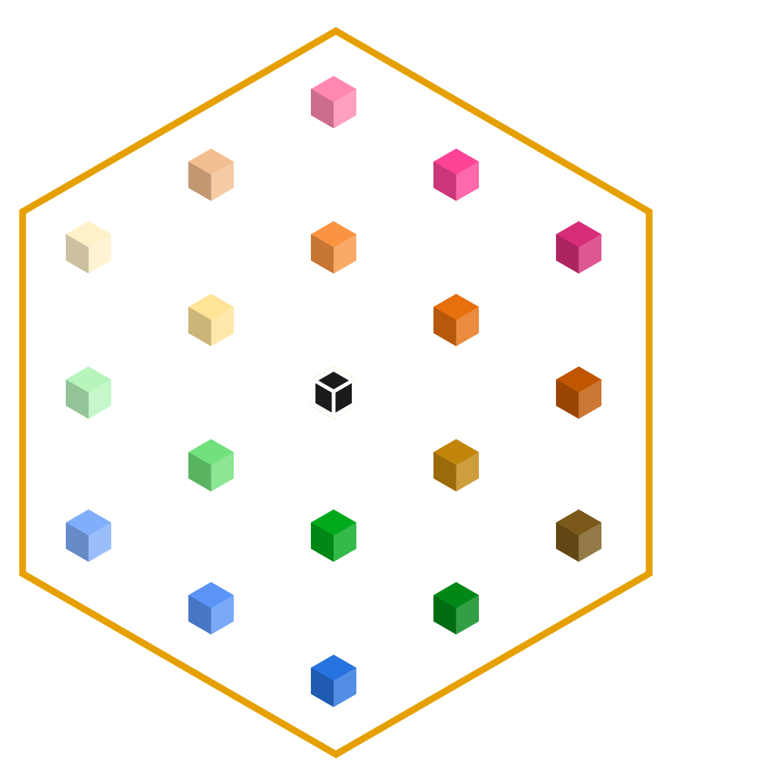
Now USWDS can keep growing without bloating your project CSS
USWDS 3.0 unbundles the design system into individual modular packages.

Slide 16
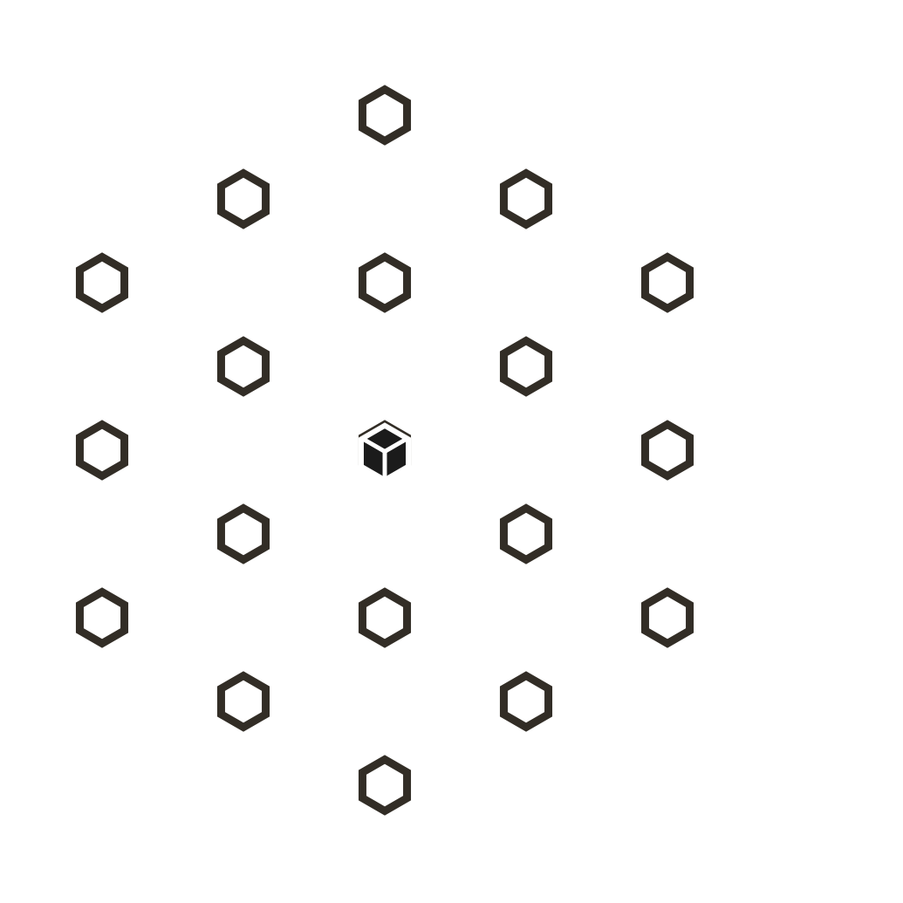
What is a package?
In USWDS, a package is an independently installable feature, component, or collection.

Slide 17
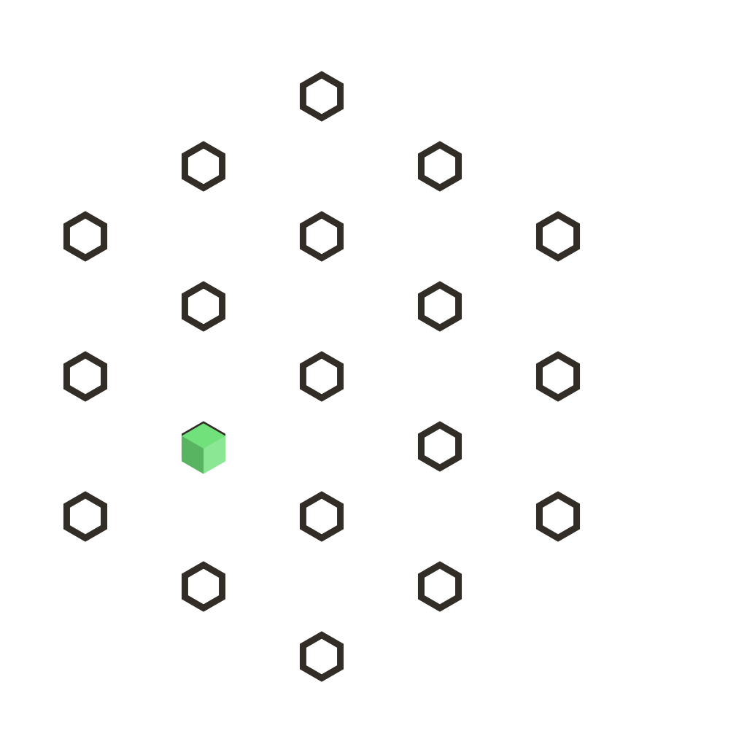
usa-banner

Slide 18
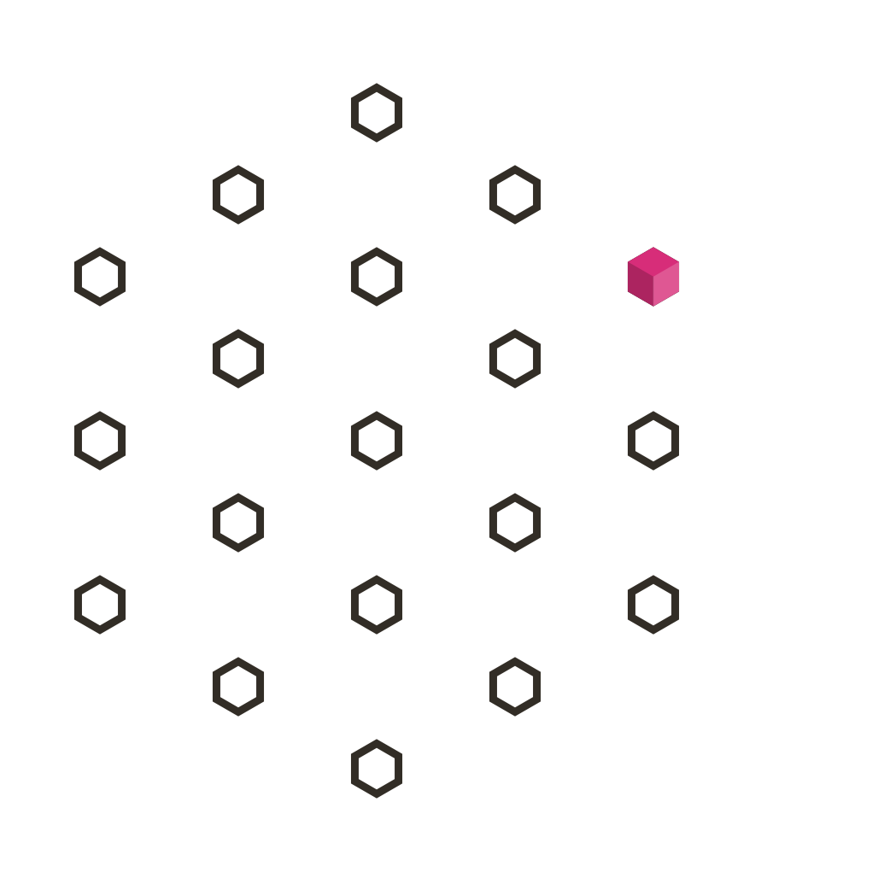
usa-footer

Slide 19
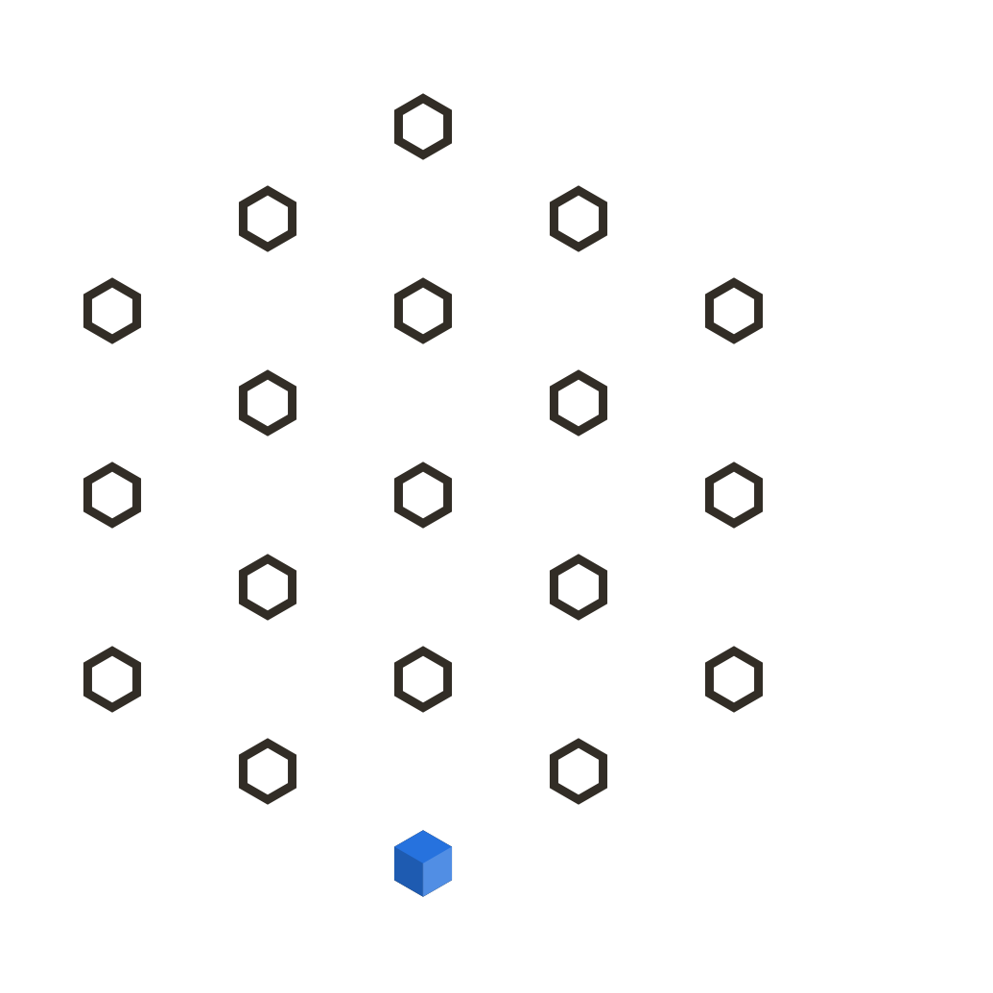
uswds-utilities

Slide 20
Package prefixes
usa-prefixed classes are components.
uswds-prefixed packages are everything else: bundles of multiple components or other non-component styles.

Slide 21

Use just the design system components your project needs
If you don’t use the whole design system, you shouldn’t include the whole design system in your CSS.

Slide 22
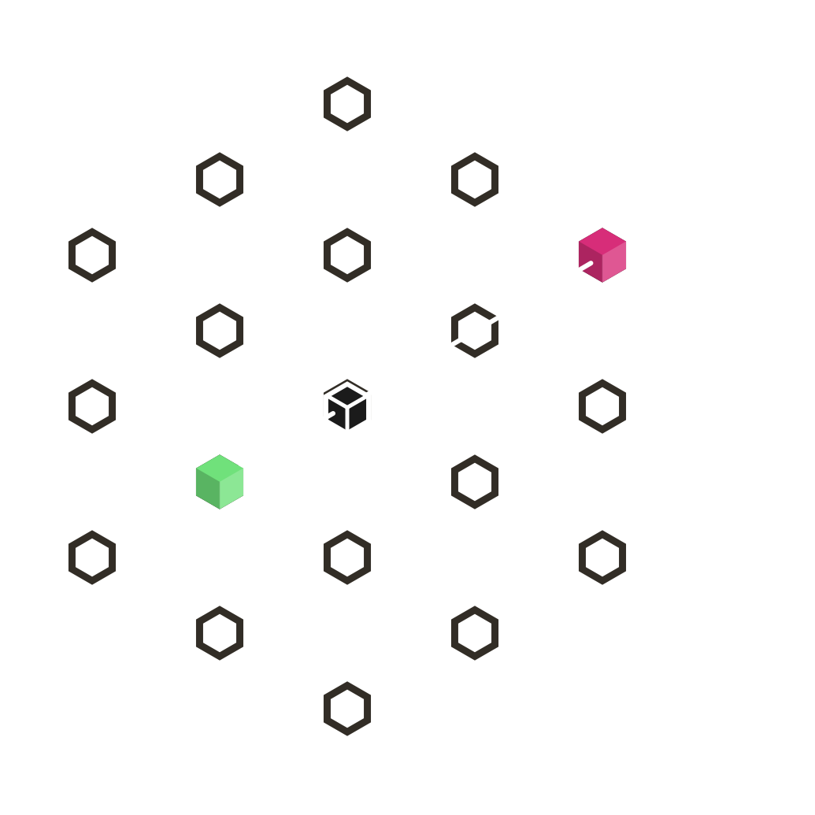
Small footprint
Just the banner and the footer

Slide 23
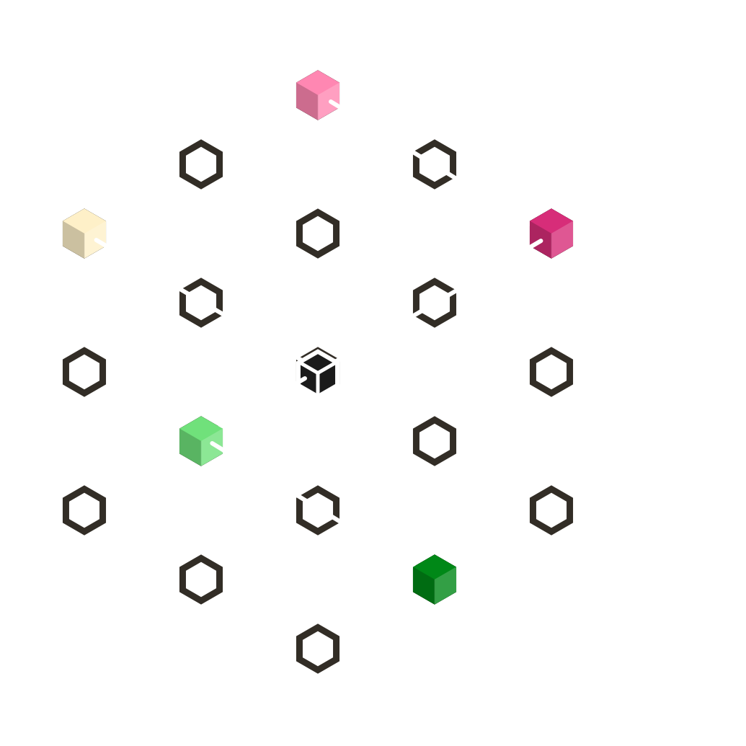
Medium footprint
Only a few components

Slide 24
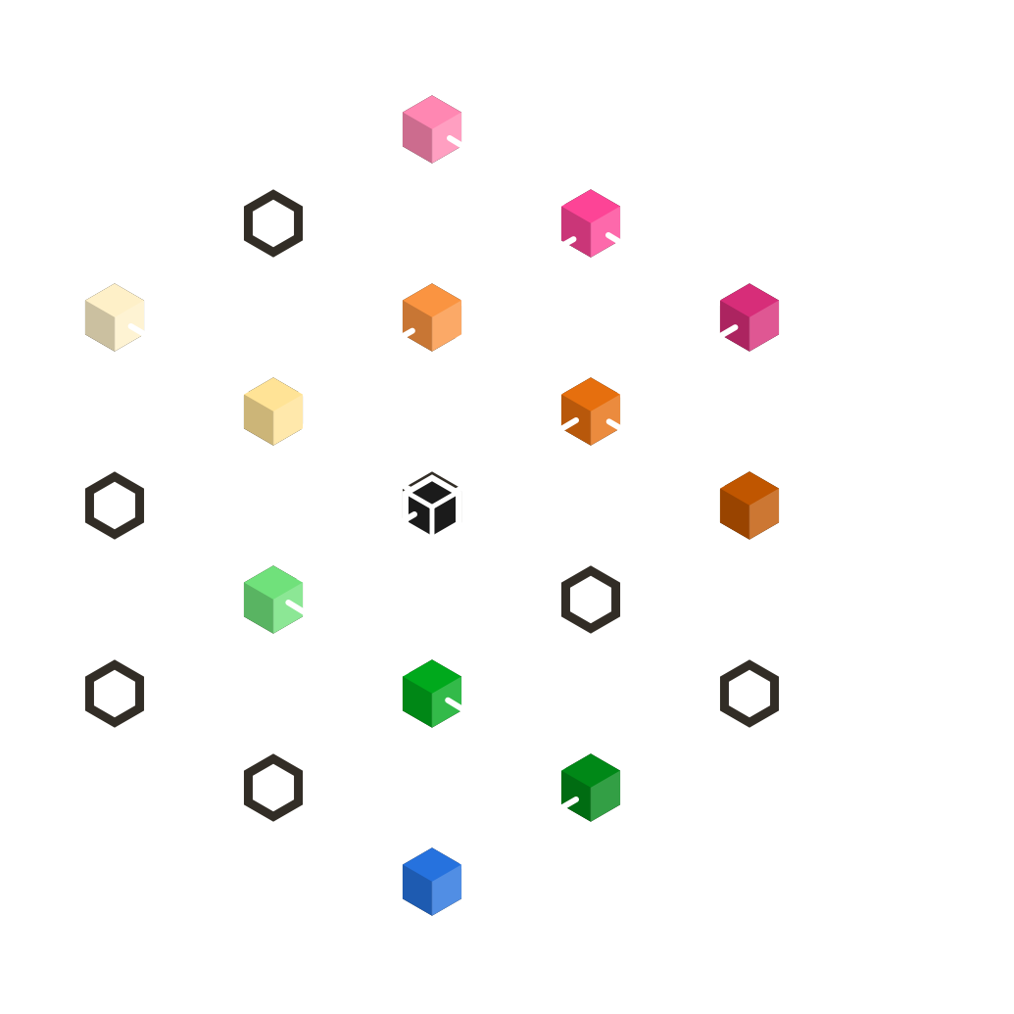
Large footprint
Even big projects probably won’t use every component.

Slide 25
Core only
A key package. Use the design language without adding CSS.

Slide 26
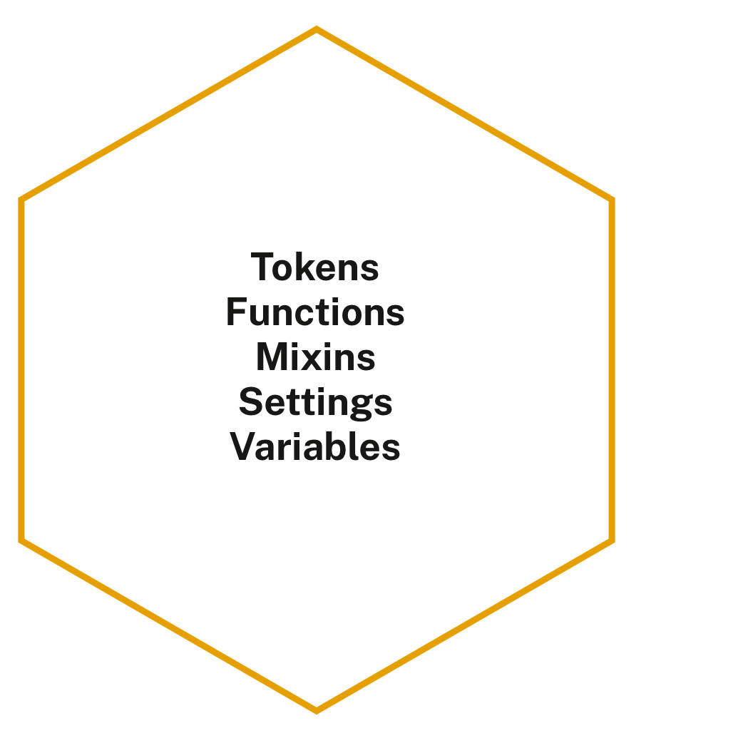
uswds-core powers every other package
It doesn’t emit CSS, but contains the complete USWDS design language.

Slide 27
uswds-core powers project settings
@use "uswds-core" with (
$theme-show-notifications: false,
$theme-font-type-sans: "public-sans",
$theme-utility-breakpoints: (
"tablet": true,
"desktop": true,
)
)

Slide 28
uswds-core powers project Sass
@use "uswds-core" as *;
.my-component {
@include u-margin-top(2);
@include u-bg("primary-vivid");
@include at-media("tablet") {
margin-top: units(2);
}
}

Slide 29
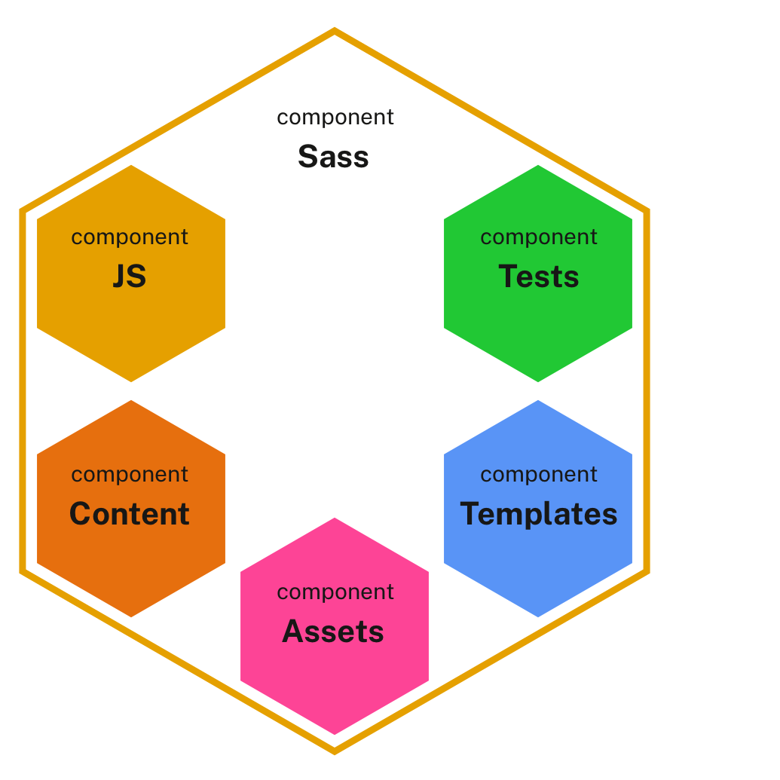
Component-centered package structure
An individual package includes everything a component needs to work.

Slide 30
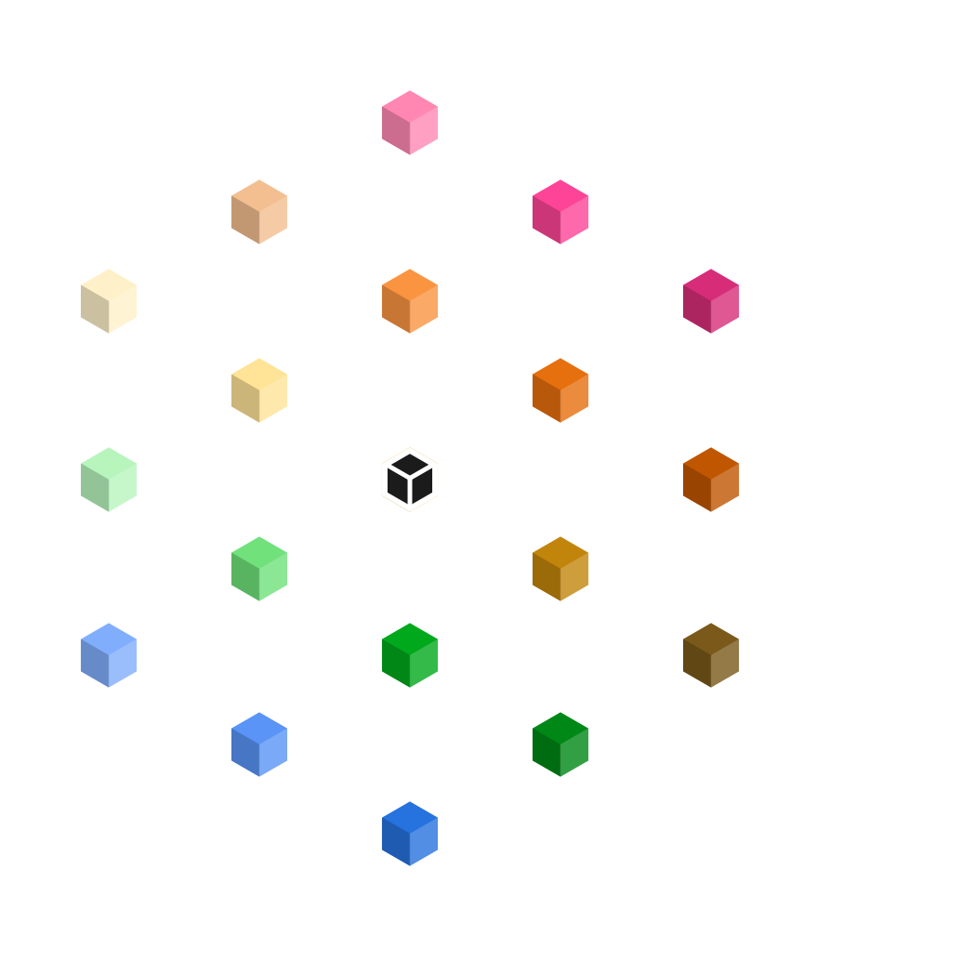
Every component is a package
Components have different needs, but each component is an individual package.

Slide 31
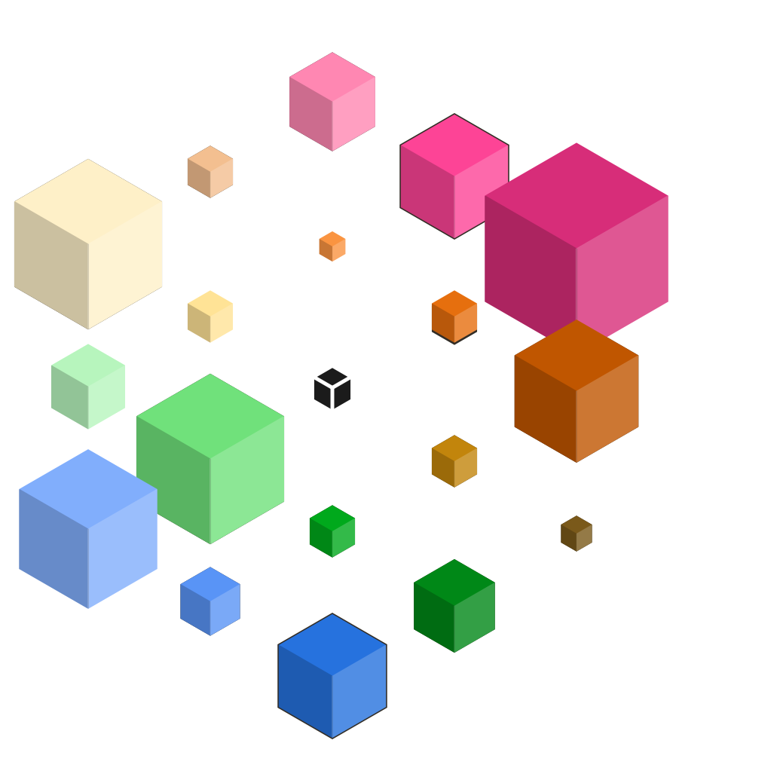
Different needs, different sizes
Some packages output a lot of CSS, some packages output only a little.

Slide 32
Everything: 417 KB
In a single bundle, the USWDS package is quite large

Slide 33
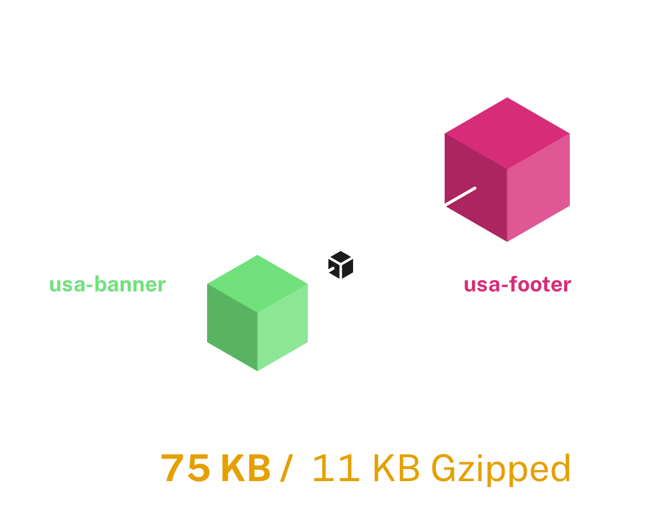
Using banner and footer
Using only a couple important components can save you over
80% versus
the bundled
version.

Slide 34
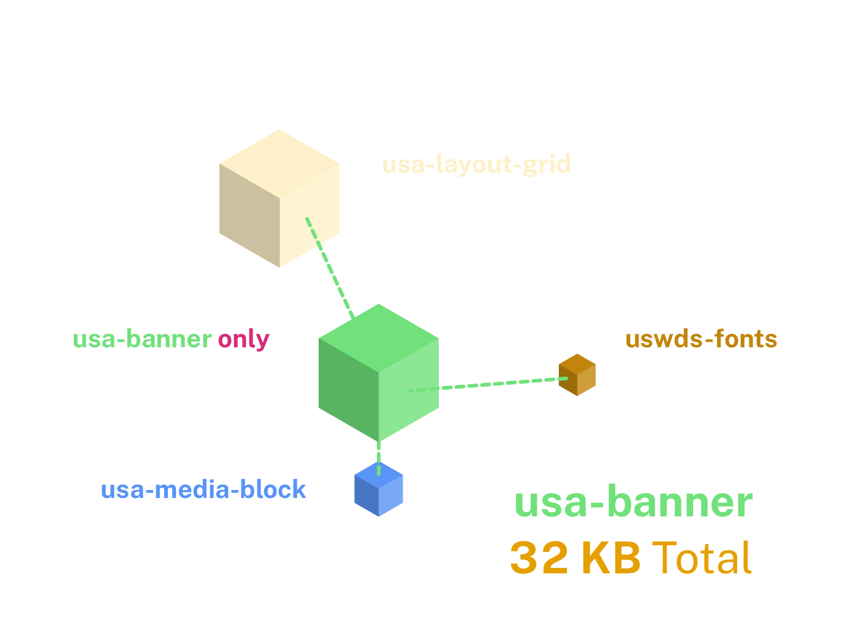
Package dependencies
The usa-banner package pulls in a few other packages
it needs to properly
display.
These are called its package
dependencies.

Slide 35
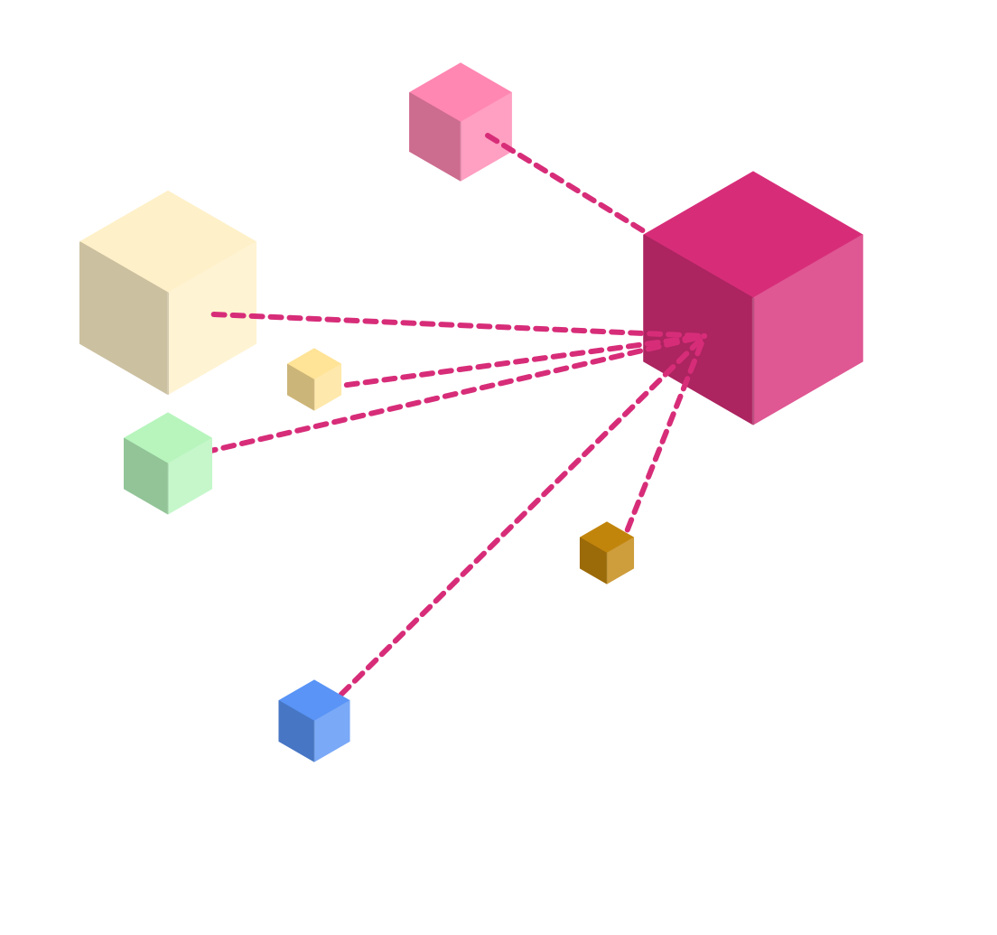
Footer dependencies
The usa-footer package also has dependencies.
Every package
is dependent on
at least one other.

Slide 36
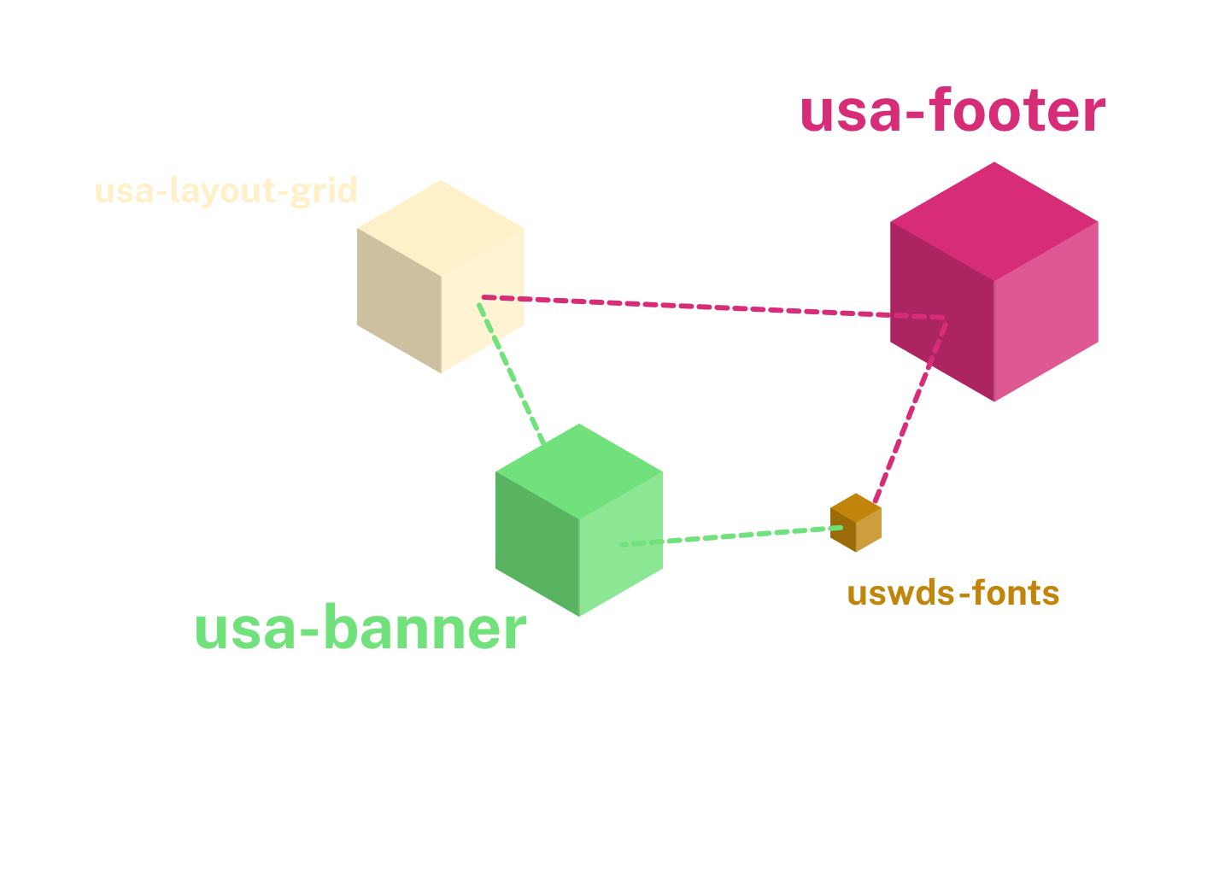
Shared dependencies are only included once
This is a key benefit
of the
Sass Module
syntax in
USWDS 3.0.

Slide 37

Some packages are affected by settings
A few packages output more or less CSS depending on your project settings.

Slide 38
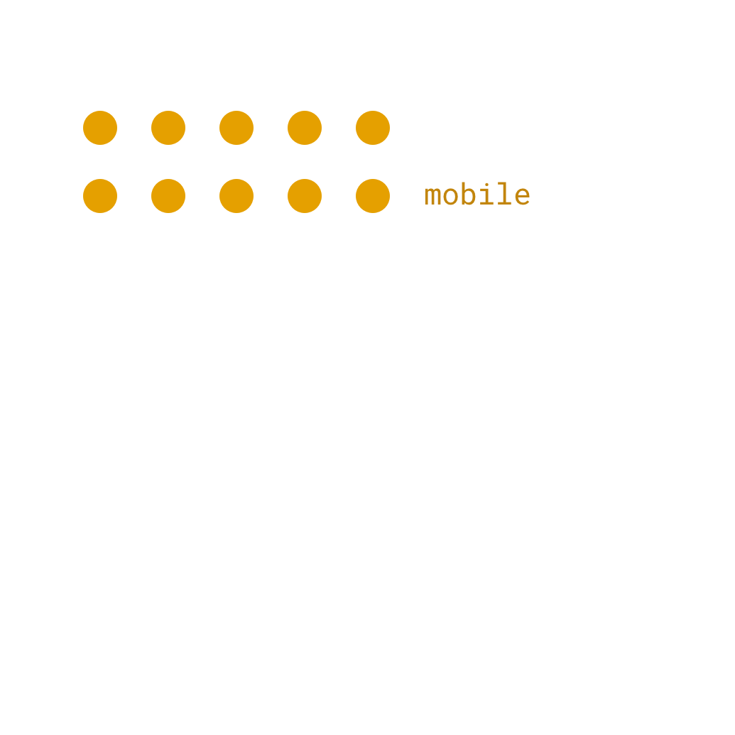
Adding responsive breakpoints adds new CSS rules
The layout grid package includes responsive classes based on the responsive breakpoints set in your project.

Slide 39
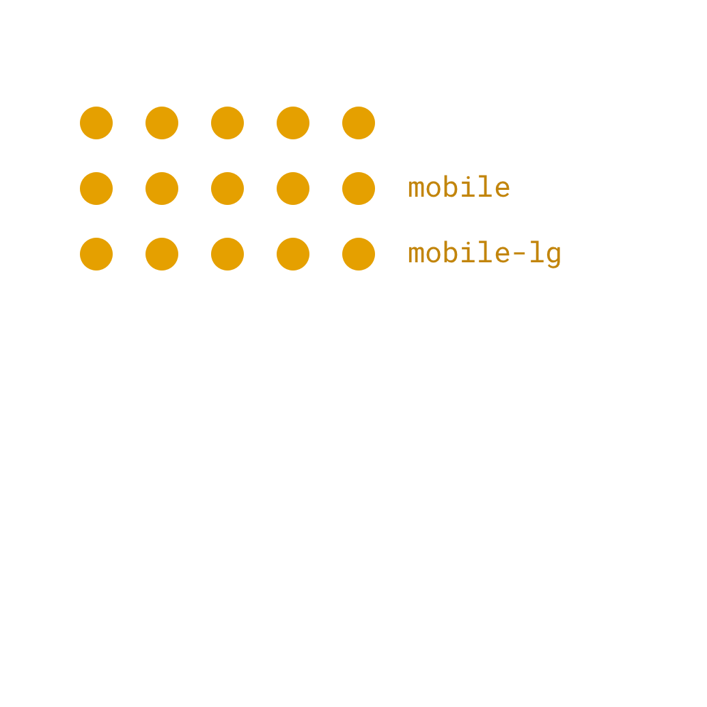
The more |breakpoints you add, the more CSS you get

Slide 40
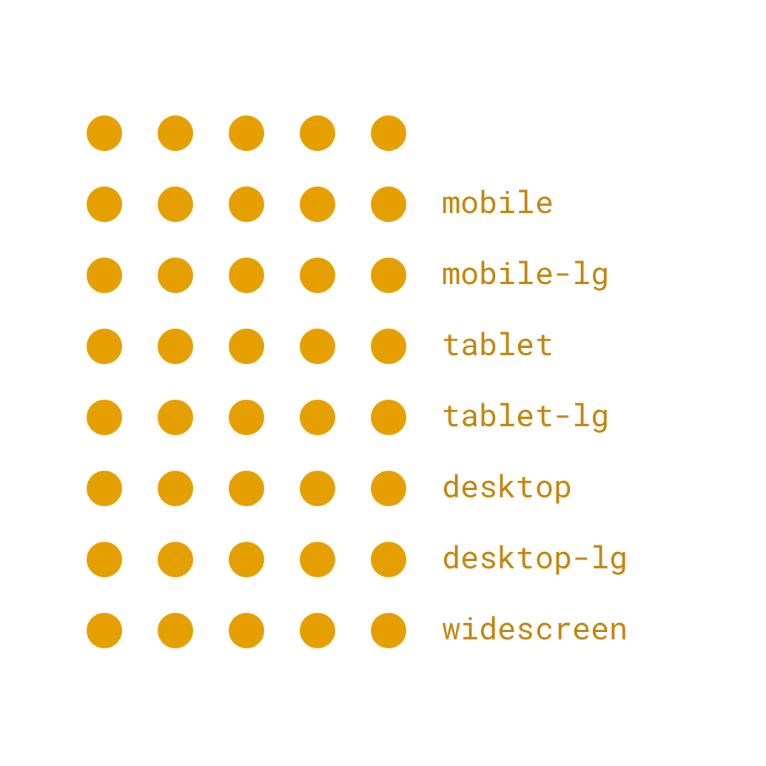
Including many breakpoints can have a big effect
Responsive breakpoints can serve as a CSS multiplier.

Slide 41

Utilities start small
Utility classes are even more sensitive to settings than the layout grid.

Slide 42
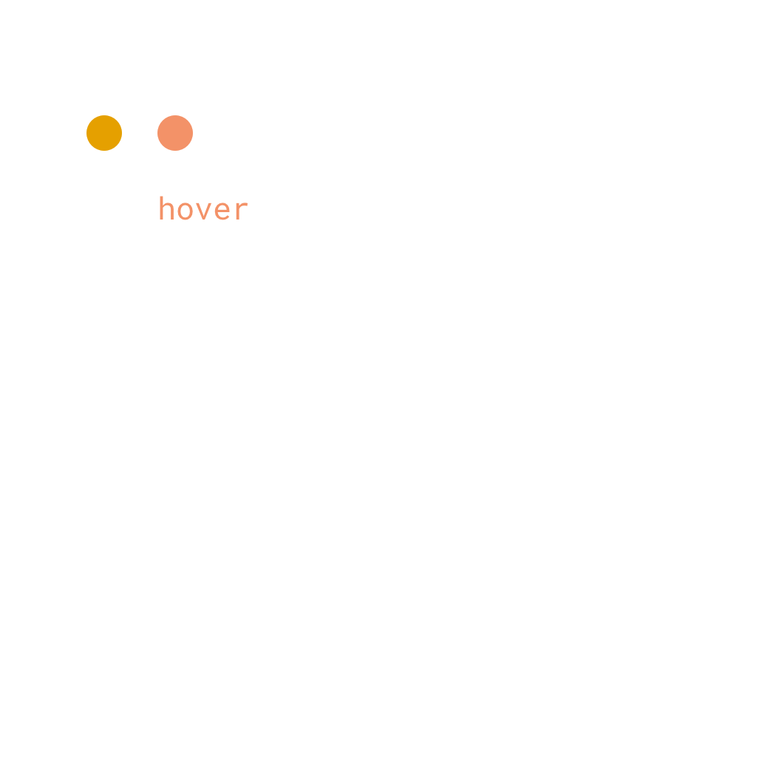
You can add state-based utility classes in settings
But each new state adds a bit more code

Slide 43
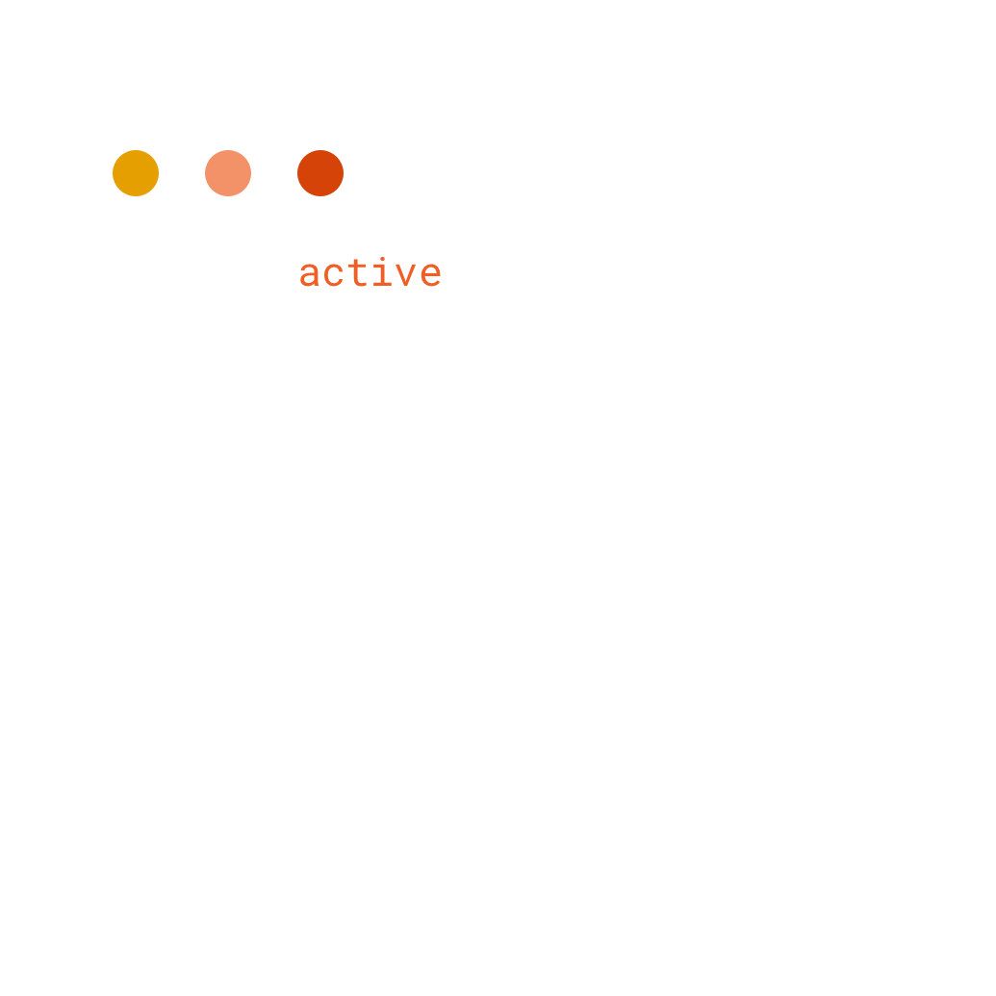
Active classes..

Slide 44
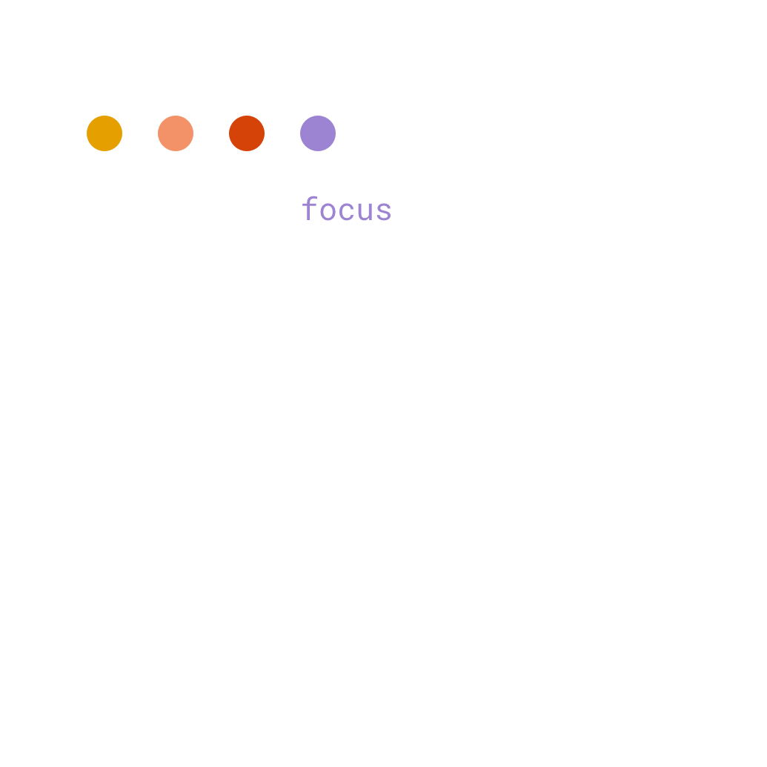
Focus classes…

Slide 45
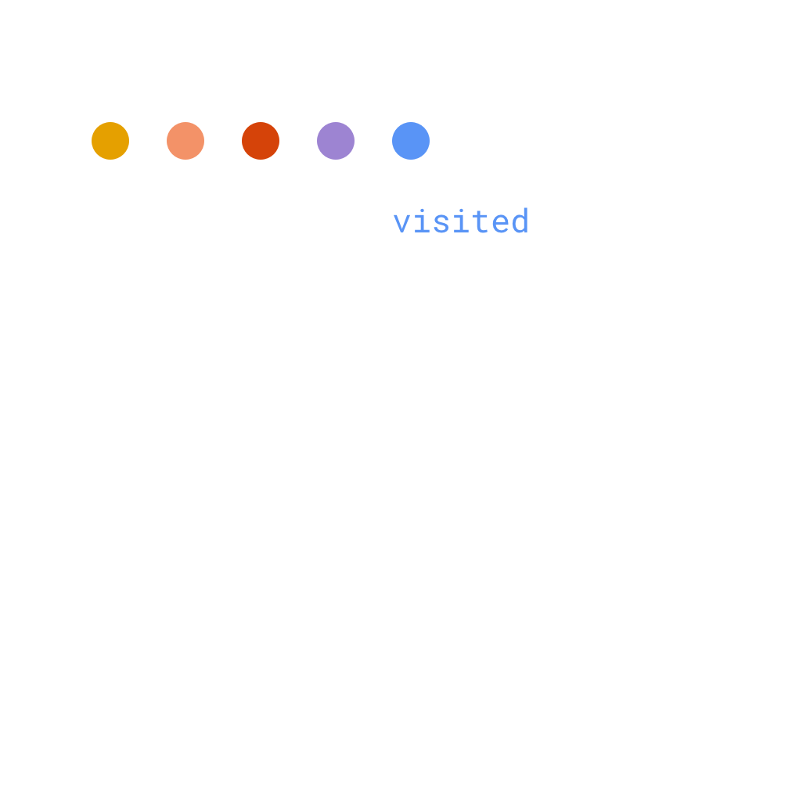
…and visited classes.

Slide 46
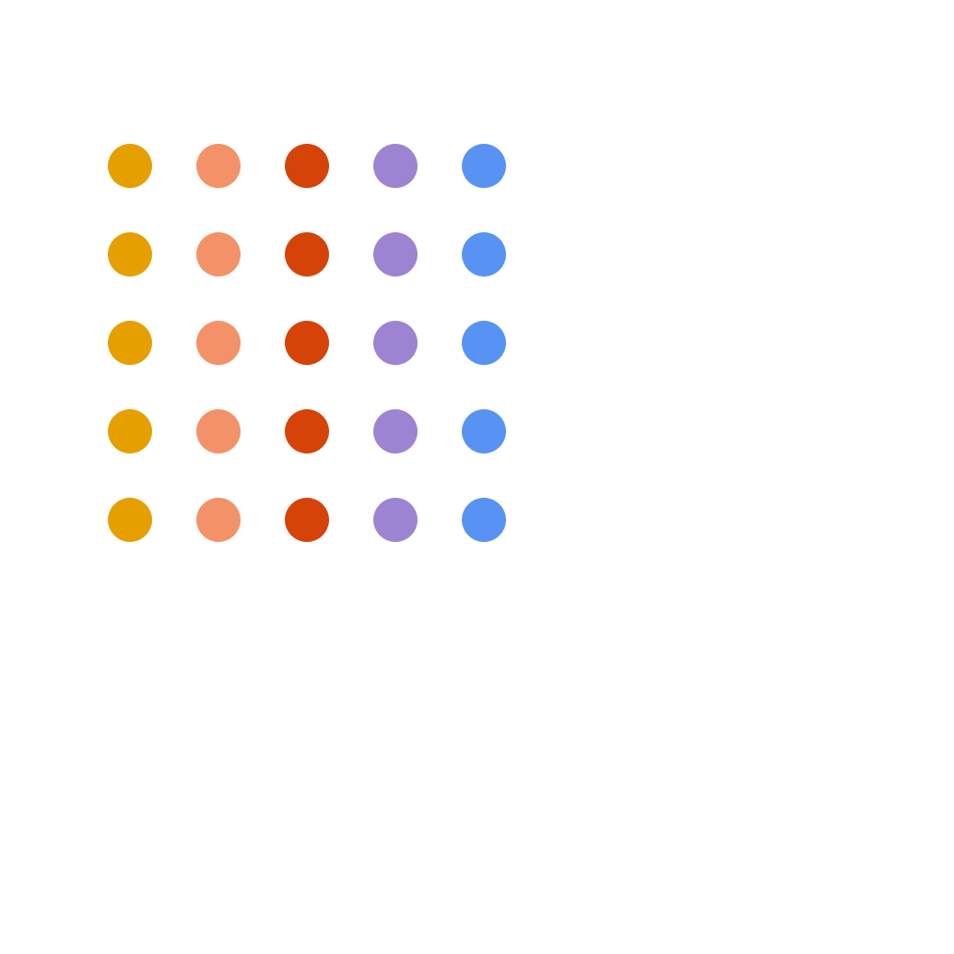
These are multiplied by the responsive breakpoints
Each new utility variant is a multiplier.

Slide 47
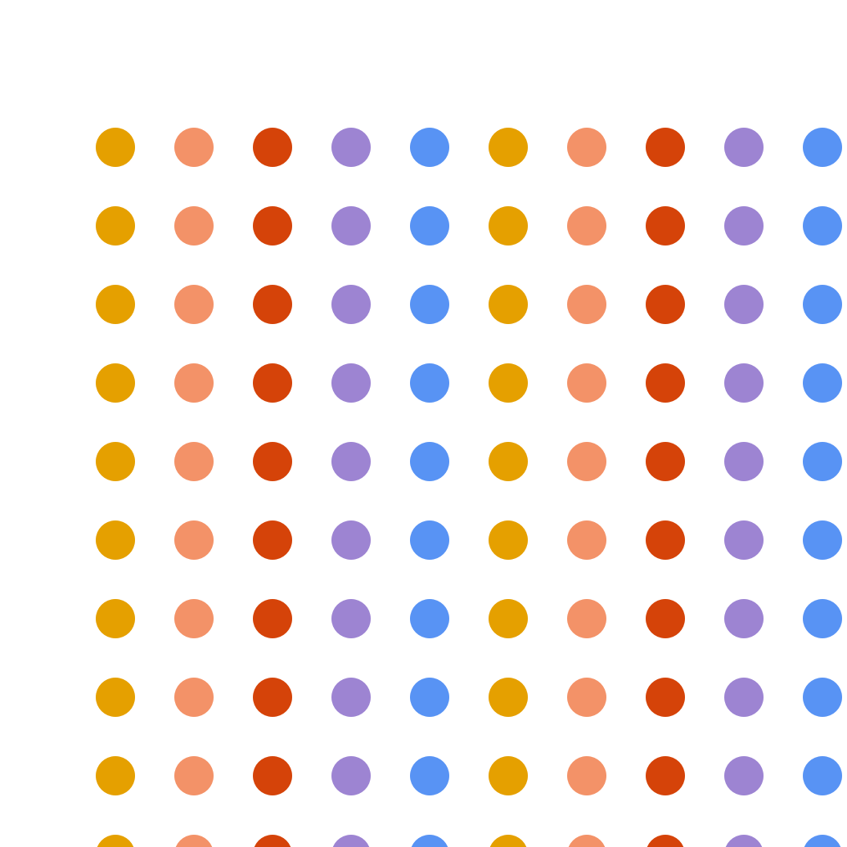
The more output utilities, the more output CSS
Even a few new variants, spread over multiple utilities can have a big effect.

Slide 48
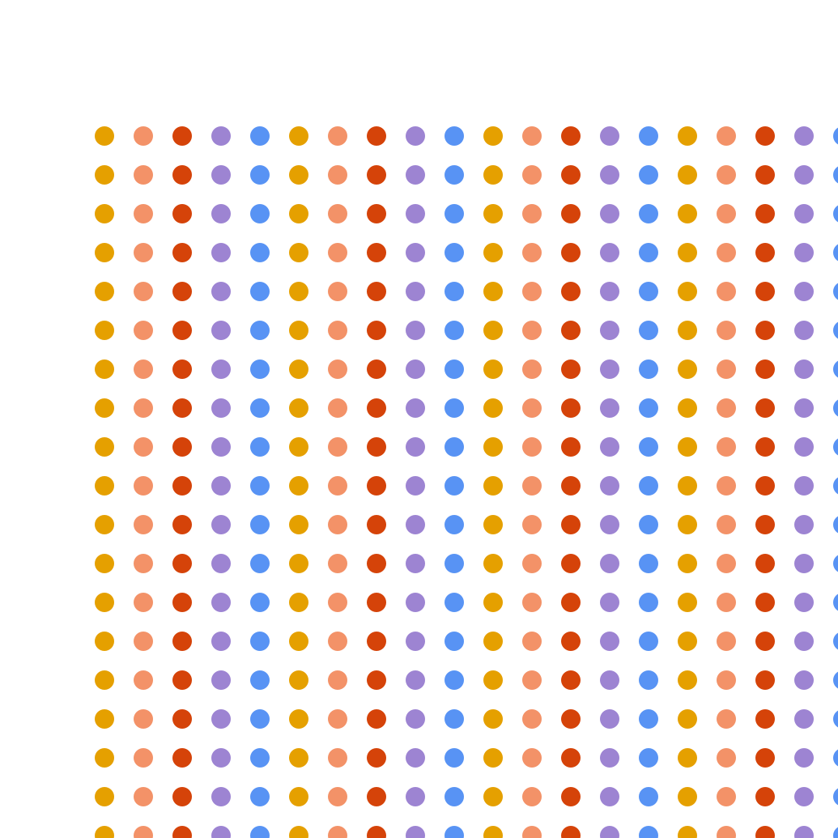
This can quickly multiply
The more utilities you're using, the bigger the effect.

Slide 49
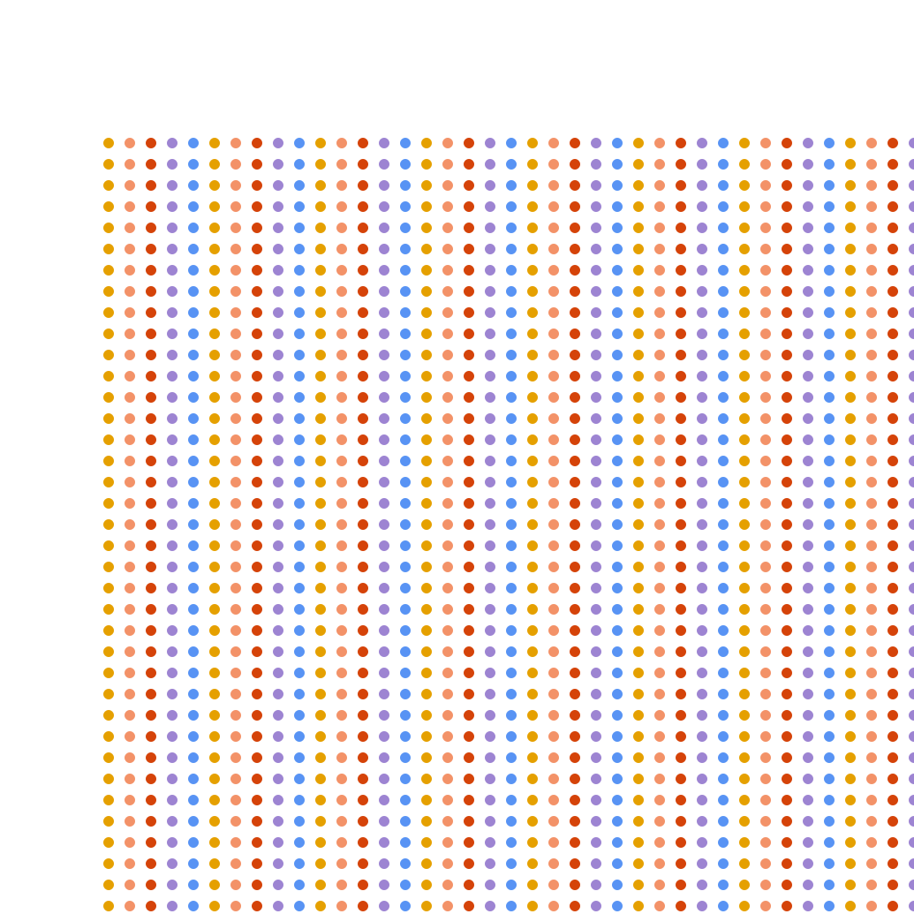
Before you know it, utility size can get out of hand
In most projects, the bulk of unused code is coming from utility classes.

Slide 50

Utilities package
The utilities package has more output
options than any
other package.

Slide 51
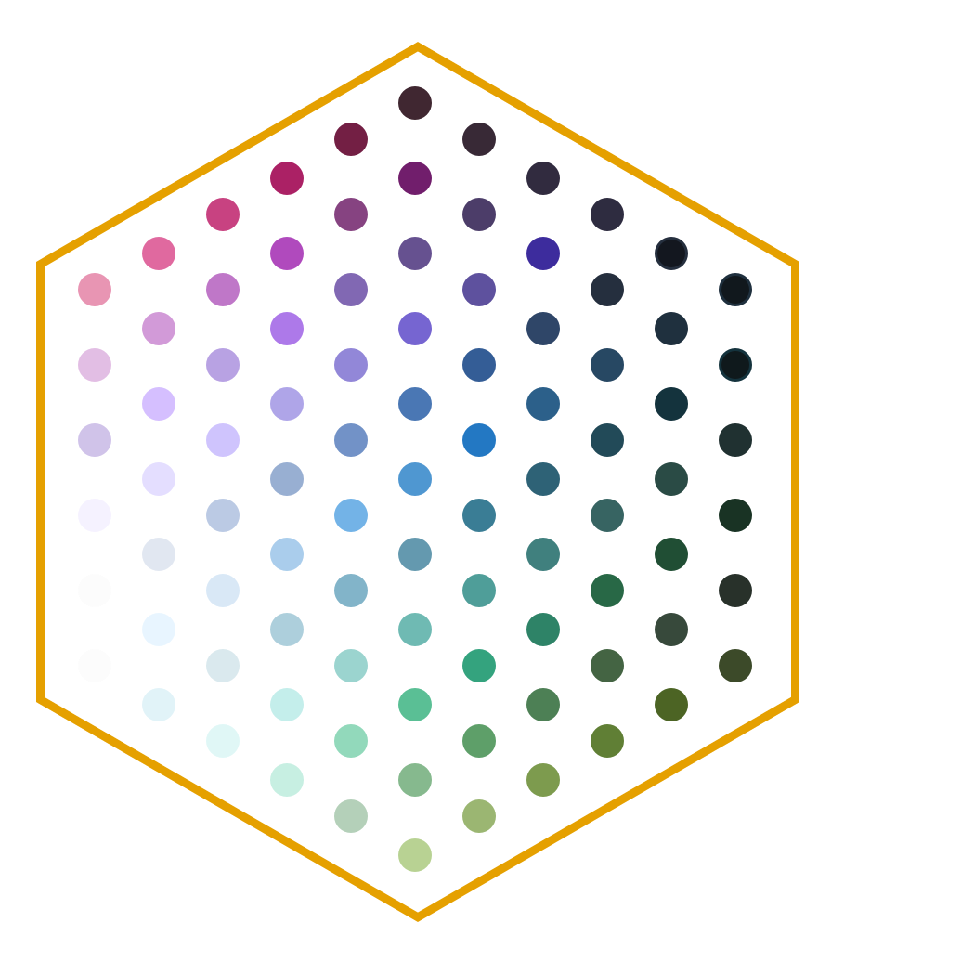
Utilities modules
Each utility in the utilities package has its own module. USWDS has over 60 utility modules.

Slide 52
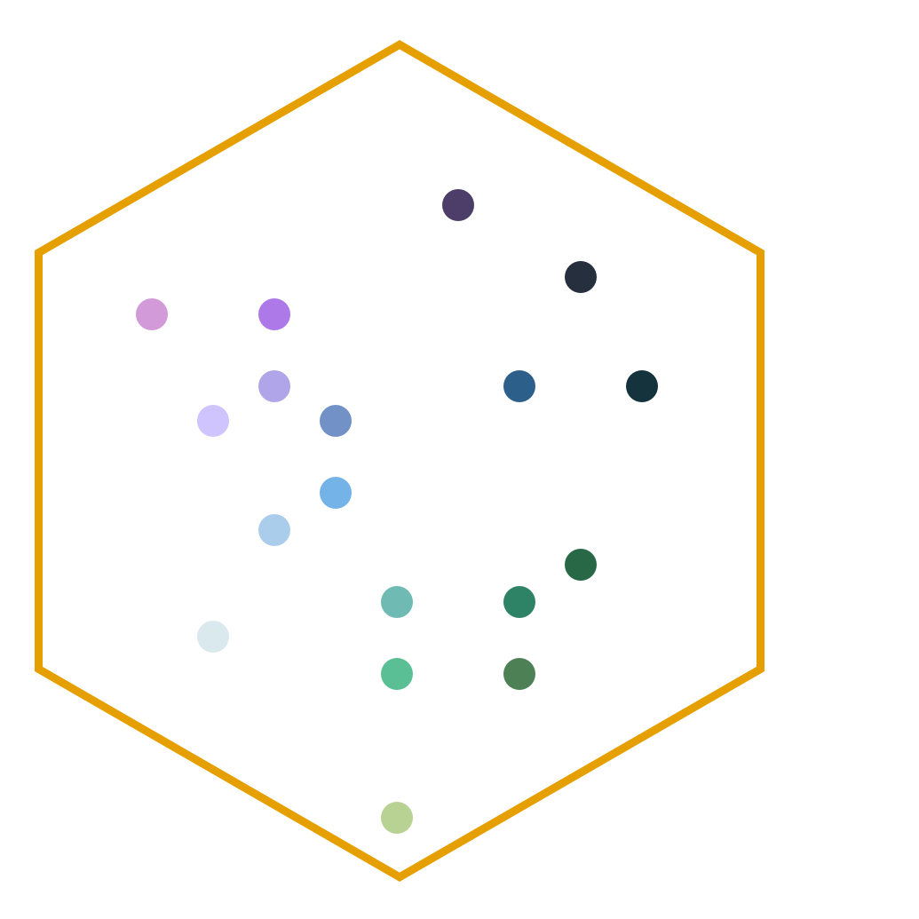
Utilities modules tailored to your project
Just as with component packages, most production websites will use only a few utility modules.

Slide 53
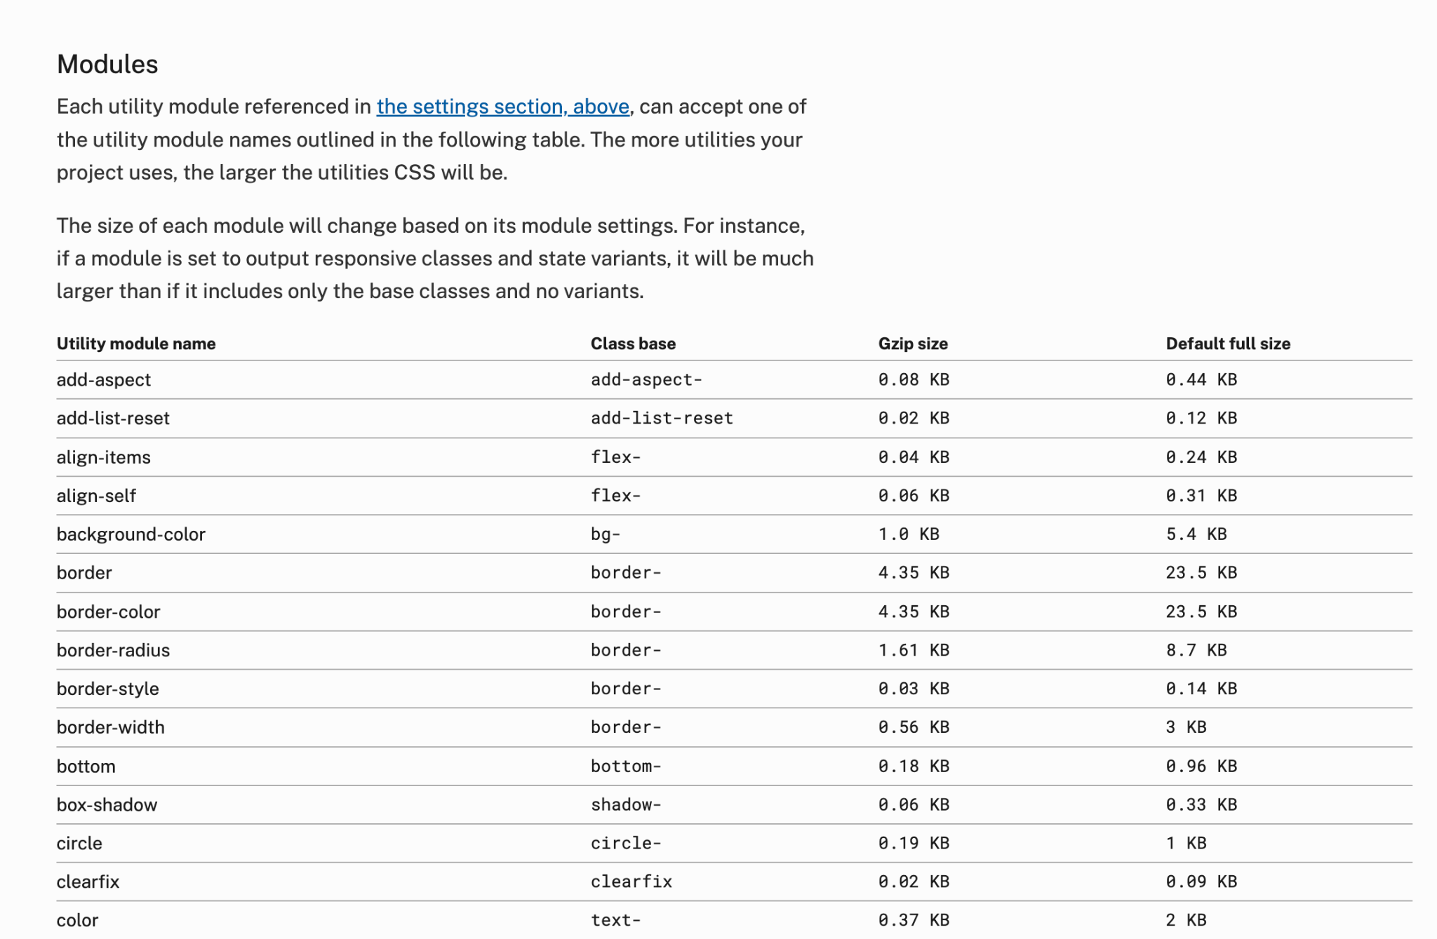
Utilities docs
Our docs go into more detail about using utility modules.
designsystem.digital.gov/utilities

Slide 54
$output-these-utilities
$output-these-utilities {
"align-items",
"background-color",
"border",
"color",
"flex",
"margin-vertical",
"padding",
"width"
}
This new setting allows you to create a list of the utility modules your project needs.

Slide 55
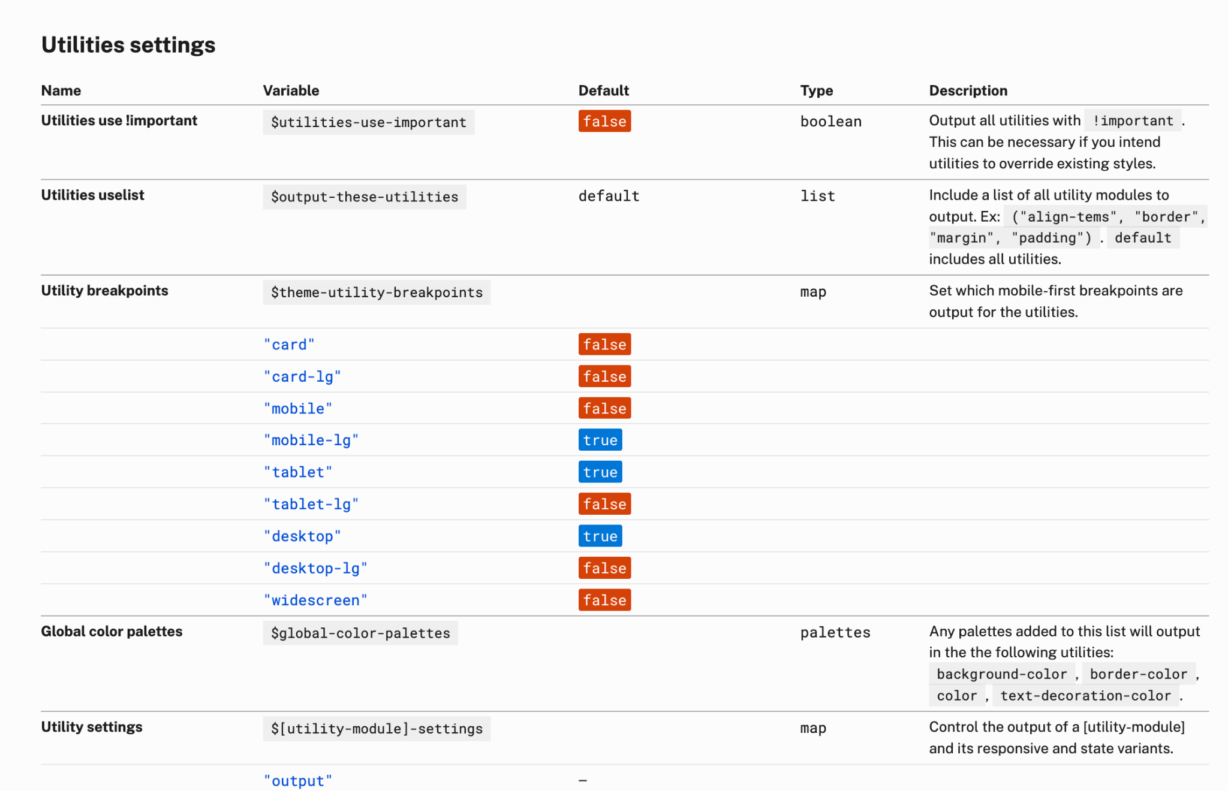
Settings docs
Adjust utility breakpoints and other utility output.
designsystem.digital.gov/documentation/settings

Slide 56
$theme-utility-breakpoints and $[module]-settings
$theme-utility-breakpoints: (
"mobile-lg": true,
"tablet": true,
"tablet-lg": true,
"desktop": true,
),
$width-settings: (
output: true,
responsive: true,
)
Control breakpoints and state variants

Slide 57
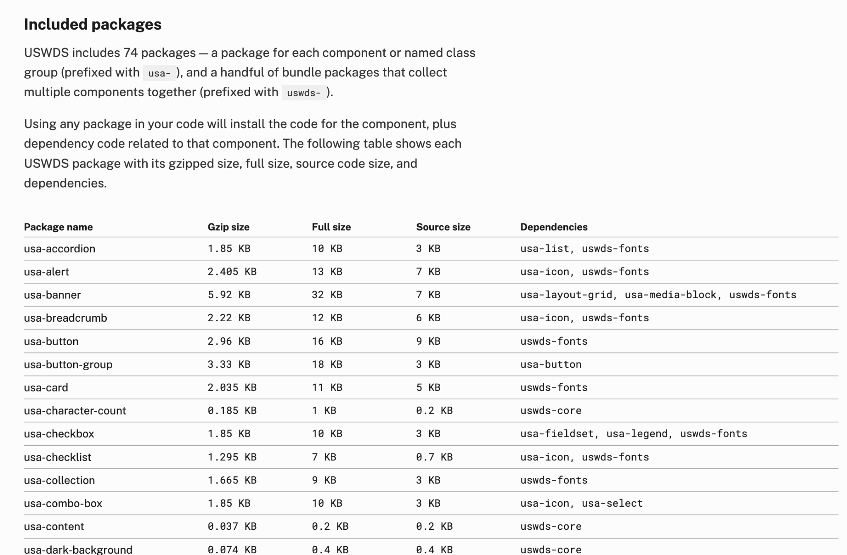
Component packages docs
Find all available packages
designsystem.digital.gov/components/packages

Slide 58
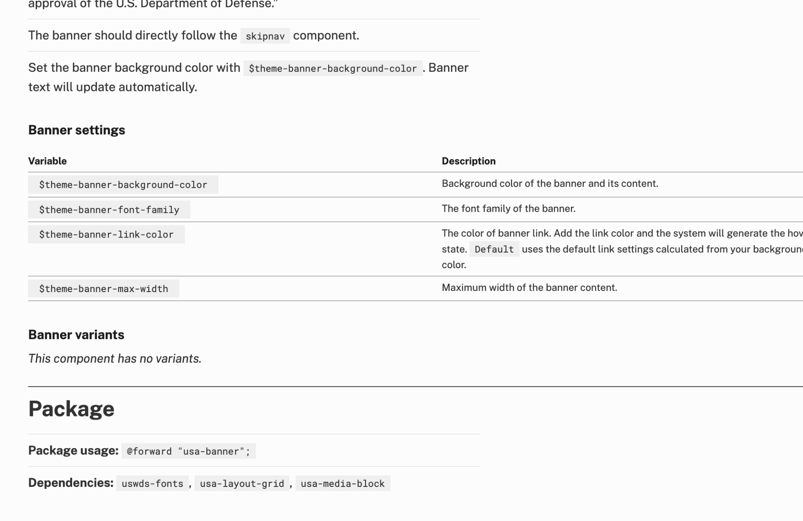
Component docs
Find package information on any component page
designsystem.digital.gov/components/banner

Slide 59
@forward
@forward "uswds"
@forward "usa-banner"
@forward "usa-footer"
@forward "uswds-utilities"
Include only your project’s packages

Slide 60
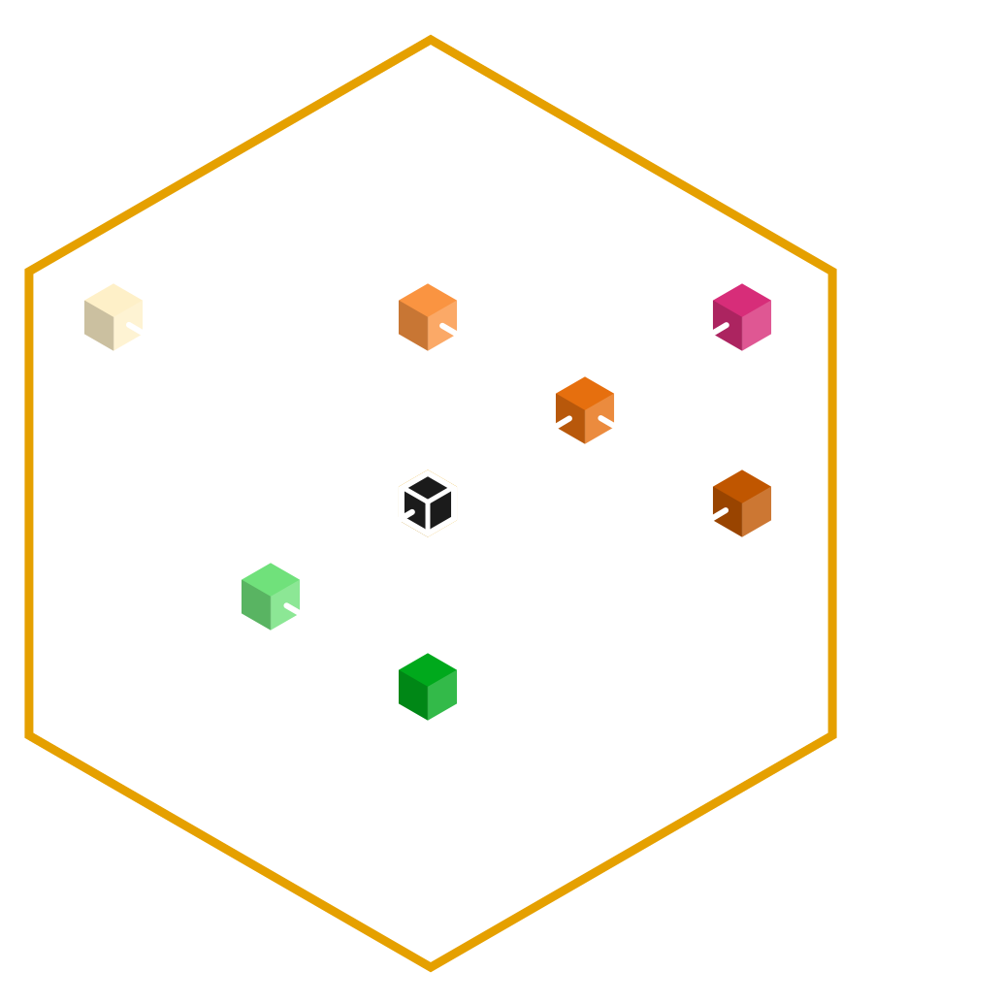
Project profile
Your Sass entry point and settings form a snapshot of what makes your project
your project.

Slide 61
James Mejia
Developer
USWDS Core Team Contractor

Slide 62
Demo

Slide 63
Q&A

Slide 64
Next month
June: Improving our contribution model
#uswds-public
github.com/uswds
designsystem.digital.gov

